Slide 2
Real-Time Sign Language Detection and Recognition
Submitted to:
Department of Computer Science and Engineering

Slide 3
Supervised by: Dr. Praveen Bhanoriya
Team Members
1. Sarthak Sharma (0827CS181187)
2. Preet Kaur Nagi (0827CS181154)
3. Rahul Ahuja (0827CS181160)
4. Poorti Rajani (0827CS181144)
Guided by:
Prof. Narendra Pal Rathore

Slide 4
Project Presentation Outline
Abstract
Introduction
Problem Statement
Survey of Existing Systems
Project Objectives
Requirement Analysis
Solution Proposed
Models and Diagrams
Conclusions and Limitations

Slide 5
Abstract
Sign Language detection by technology is an overlooked concept despite there being a large social group which could benefit by it. There are not many technologies which help in connecting this social group to the rest of the world. Understanding sign language is one of the primary enablers in helping users of sign language communicate with the rest of the society. Image classification and machine learning can be used to help computers recognize sign language, which could then be interpreted by other people. We will be using Convolutional neural networks to recognize sign language gestures. The image dataset used consists of static sign language gestures captured on an RGB camera. Preprocessing was performed on the images, which then served as the cleaned input. We will present results obtained by retraining and testing this sign language gestures dataset on a convolutional neural network model that we will build.
The model consists of multiple convolution filter inputs that are processed on the same input. By this project we will detect Sign Language gestures in Real-time using Deep Learning , OpenCV, and Tensorflow. which will be helpful for deaf and disabled people.

Slide 6
Introduction
There have been several advancements in technology and a lot of research has been done to help the people who are deaf and dumb. Aiding the cause, Deep learning, and computer vision can be used too to make an impact on this cause. This can be very helpful for the deaf and dumb people in communicating with others as knowing sign language is not something that is common to all. In this sign language recognition project, we create a sign detector, which detects alphabets from A to Z that can very easily be extended to cover a vast multitude of various types of signs and hand gestures.
Sign Language is the form of communication among deaf & dumb people. They use signs and gestures to convey messages and express themselves to others. This would require both the parties involved in the communication process to know the meaning of the signs/gestures that the other person is trying to convey. Since we cannot expect everyone to know the meaning of different signs/gestures, this system acts as a medium that converts signs/gestures to speech. Sign Language Recognition is a challenge that can be approached in many ways. Two of its main approaches are sensor-based and image-based. This system uses the image-based approach to sign language recognition.

Slide 7
The Problem Statement
Speech impaired people use hand signs and gestures to communicate. They face problems in communicating with people around them. Their family members and close friends learn sign language to communicate with them but other than that, normally, people do not know sign language and don’t even try to learn, as they do not need it in their day-to-day life. The society does not understand how difficult it is for them to communicate with someone who does not know sign language.
Hence there is a need of a system which recognizes the different signs, gestures and conveys the information to the normal people.
By using technologies such as image processing and machine learning one can build a system which converts sign language to text or speech. These systems can be of great help to dumb people as they can easily communicate with anyone using such system.
So that, it bridges the gap between physically challenged people and normal people.

Slide 8
Survey of Existing Systems
We have gone through other similar works that are implemented in the domain of sign language recognition. The summaries of each of the project works are mentioned below:
A Survey of Hand Gesture Recognition Methods in Sign Language Recognition.
Communication between Deaf-Dumb People and Normal People
Intelligent Sign Language Recognition Using Image Processing
Sign Language Interpreter using Image Processing and Machine Learning

Slide 9
Objectives
The objective of the Sign Language recognition project is to successfully create a sign detector ,which will detect alphabets from A to Z that can very easily be extended to cover a vast multitude of other signs and hand gestures including numbers also.
The project aims to aid individuals with inherent or acquired hearing disability facilitate real-time communication with deaf with high accuracy. We will develop this project using OpenCV and Keras modules of python. Main Objective of this Project is to create a high accuracy classification model which should give accurate predictions in training data as well as in testing data (The data our model has not seen before.)

Slide 10
Requirement Analysis
Camera
Capable Processor
Python (3.7.4)
IDE (Jupyter)
Numpy (version 1.16.5)
cv2 (OpenCV) (version 3.4.2)
Keras (version 2.3.1)
Tensorflow (as keras uses tensorflow in backend and for image preprocessing) (version 2.0.0)

Slide 11
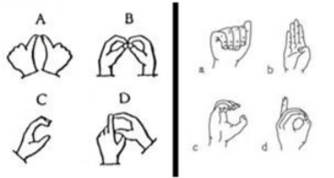
Solution Proposed
Our proposed system is sign language recognition system using convolution neural networks which recognizes various hand gestures by capturing video and converting it into frames. Then the hand pixels are segmented and the image it obtained and sent for comparison to the trained model.
Thus, our system is more robust in getting exact text labels of letters.
Basic gestures in American Sign Language and Indian Sign Language.

Slide 12
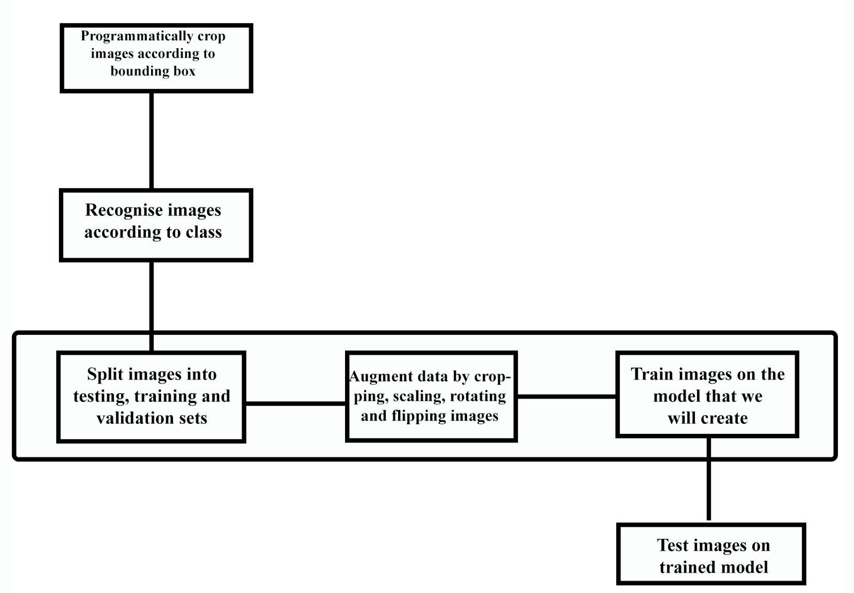
Models/Diagrams
Implementation
Approach

Slide 13
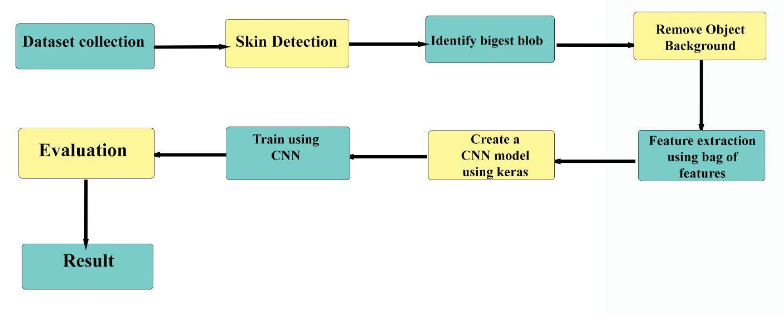
Models/Diagrams Contd.

Slide 14
Conclusion and Limitation
Sign Language Recognition System has been developed from classifying only static signs and alphabets, to the system that can successfully recognize dynamic movements that comes in continuous sequences of images. Researcher nowadays are paying more attention to make a large vocabulary for sign language recognition systems. Many researchers are developing their Sign Language Recognition System by using small vocabulary and self-made database. Large database build for Sign Language Recognition System is still not available for some of the country that involved in developing Sign Language Recognition System. Using their own ideas and limitations for the Sign Language Recognition System, the comparison of one method to another method is still subjective. Fair and direct comparison between approaches are limited because of the variation of sign language in different countries and the difference in limitation set by each researcher. Variation of sign language in most of the country is based on their grammar and their way to present each word, such as presenting the language by word or by sentence.
In this Project, we have gone through an automatic sign language gesture recognition system in real-time, using different tools.
Although our proposed work expected to recognize the sign language and convert it into the text which can be useful for deaf and dumb people there’s still a lot of scope for possible future work.

Slide 15
Q&A

Slide 16
THANKS

